Slide 1
Computational Physics Part III: Computer Simulations
UCAS UNDERGRADUATE COURSE
Jure Dobnikar, May 2023

Slide 2
Literature:
R.W. Hamming: Numerical Methods for Scientists and Engineers, Dover Publications, 1973 T. Pang: An Introduction to Computational Physics, Cambridge University Press, 1997 D. Frenkel, B. Smit: Understanding Molecular Simulation Academic Press, 2002

Slide 3
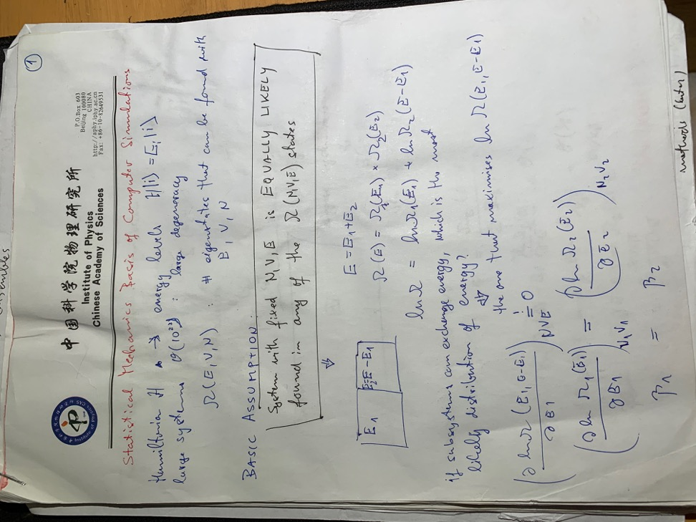
PART III: COMPUTER SIMULATIONS STATISTICAL MECHANICS BASIS
Simple but non-trivial: important laws follow directly

Slide 4
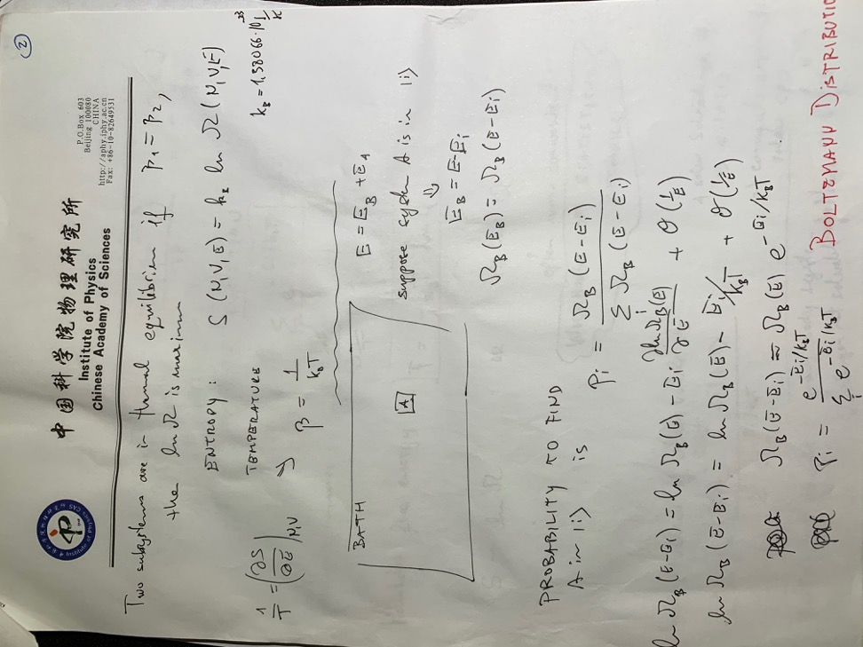
PART III: COMPUTER SIMULATIONS STATISTICAL MECHANICS BASIS
Two weakly-coupled systems

Slide 5

PART III: COMPUTER SIMULATIONS STATISTICAL MECHANICS BASIS
Coupling with thermal bath
Remember: $\frac{∂\ln{Ω_{B}(E)}}{∂E}≡ β$

Slide 6
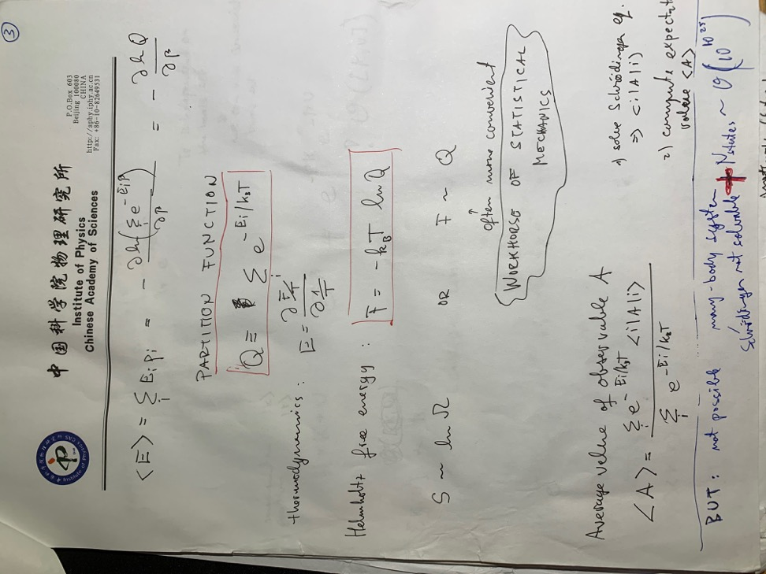
PART III: COMPUTER SIMULATIONS STATISTICAL MECHANICS BASIS

Slide 7
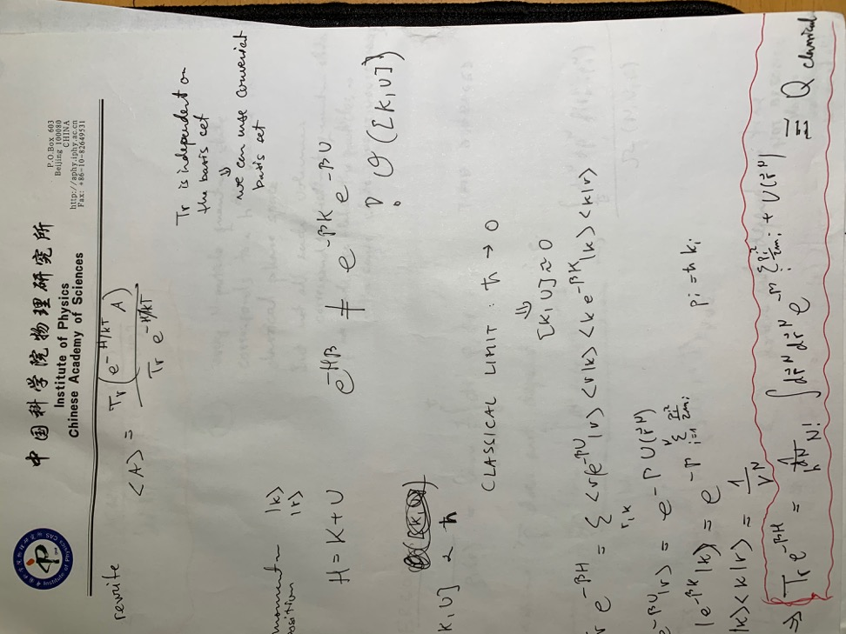
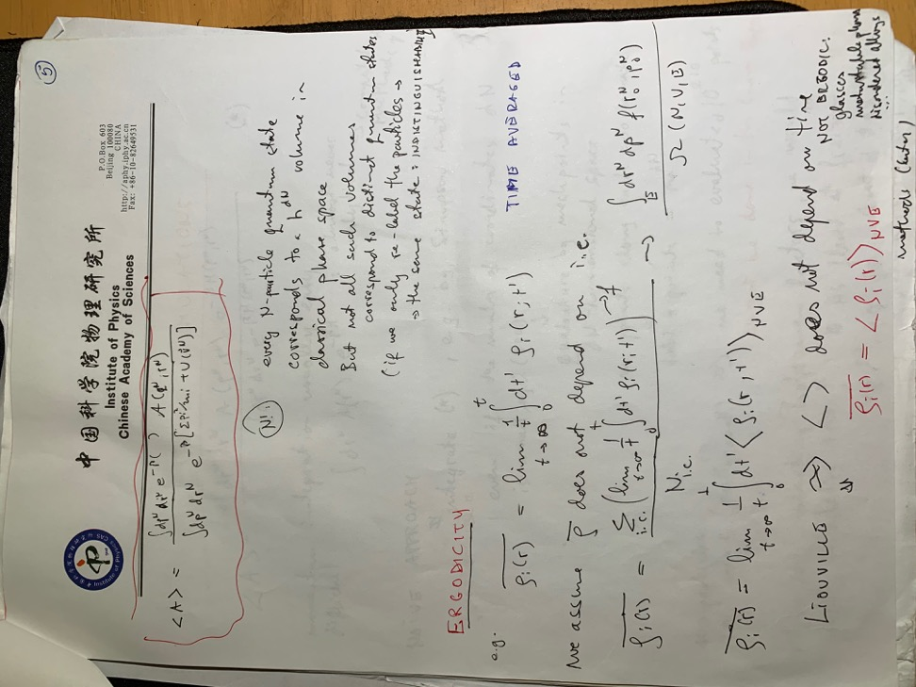
PART III: COMPUTER SIMULATIONS STATISTICAL MECHANICS BASIS

Slide 8
PART III: COMPUTER SIMULATIONS STATISTICAL MECHANICS BASIS
Most systems we are interested in are likely to be ergodic. Therefore, properly evaluated time averages along simulation trajectories are equivalent to ensemble averages. This is a basis of two major approaches to molecular simulations: MOLECULAR DYNAMICS (MD) and MONTE CARLO (MC).

Slide 9
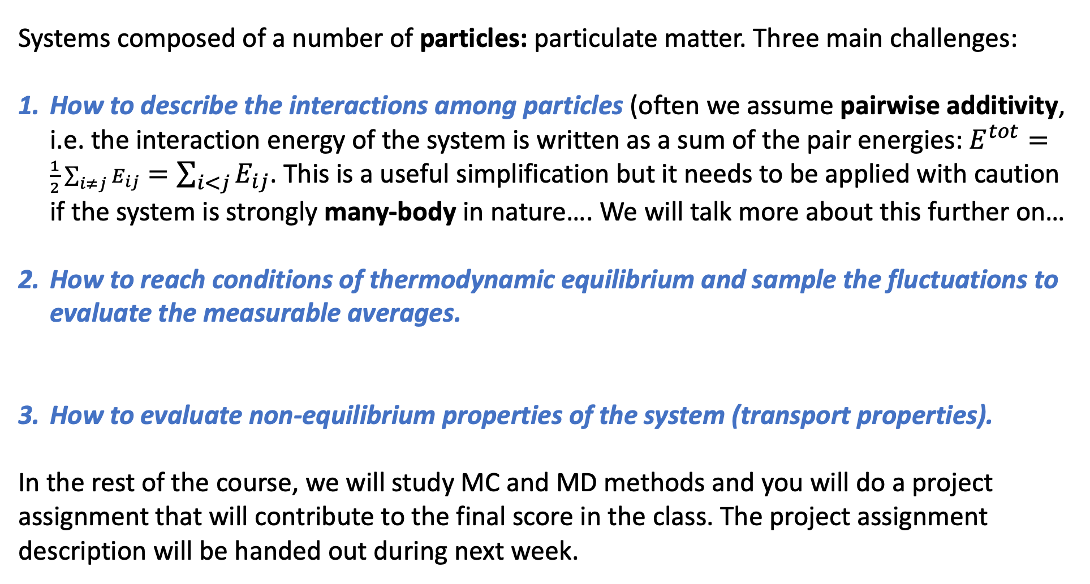
PART III: COMPUTER SIMULATIONS
Systems composed of a number of particles: particulate matter. Three main challenges:
How to describe the interactions among particles (often we assume pairwise additivity, i.e. the interaction energy of the system is written as a sum of the pair energies: $E^{tot}=\frac{1}{2}\sum_{i≠j}{E_{ij}}=\sum_{i<j}{E_{ij}}$. This is a useful simplification but it needs to be applied with caution if the system is strongly many-body in nature…. We will talk more about this further on…
How to reach conditions of thermodynamic equilibrium and sample the fluctuations to evaluate the measurable averages.
How to evaluate non-equilibrium properties of the system (transport properties).
In the rest of the course, we will study MC and MD methods and you will do a project assignment that will contribute to the final score in the class. The project assignment description will be handed out during next week.

Slide 10
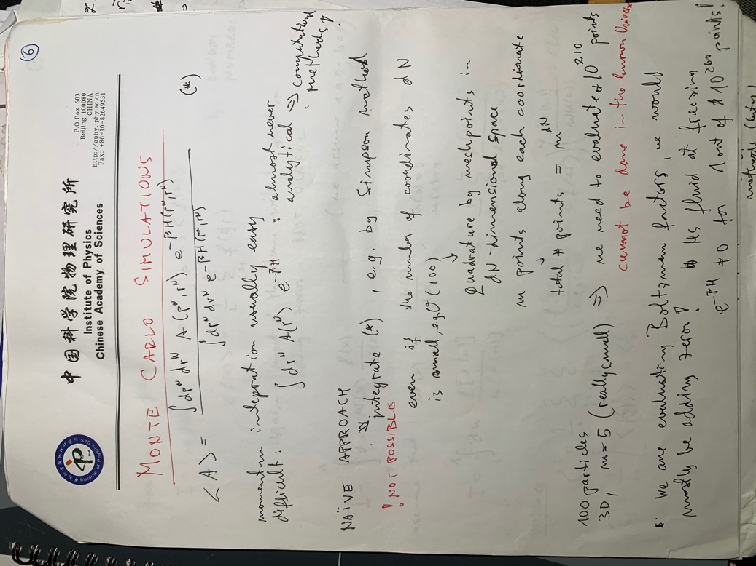
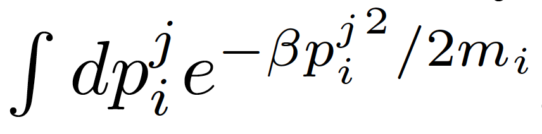
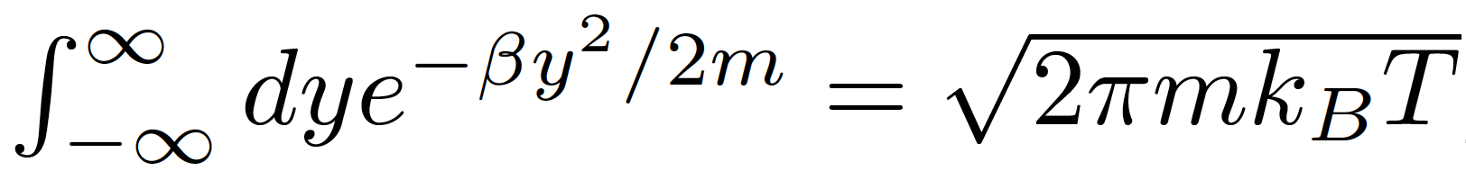
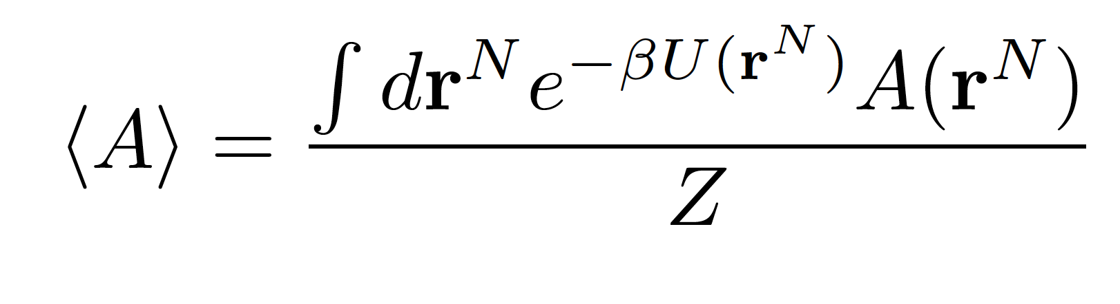
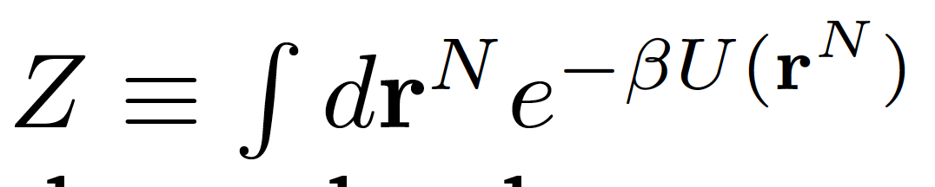
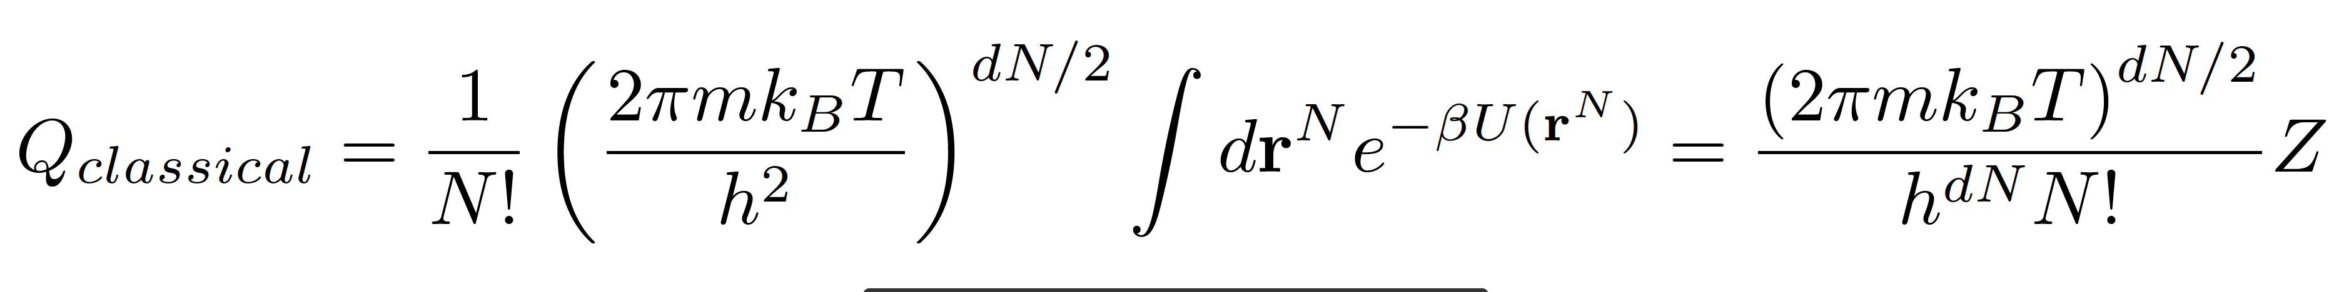
PART III: COMPUTER SIMULATIONS MONTE CARLO SIMULATIONS

Slide 11
PART III: COMPUTER SIMULATIONS MONTE CARLO SIMULATIONS
NAÏVE APPROACH: integrate Z e.g. by Simpson rule…
NOT POSSIBLE !!!
Number of lattice points for a system of N particles in d-dimensional space with m lattice points in each dimension

Slide 12
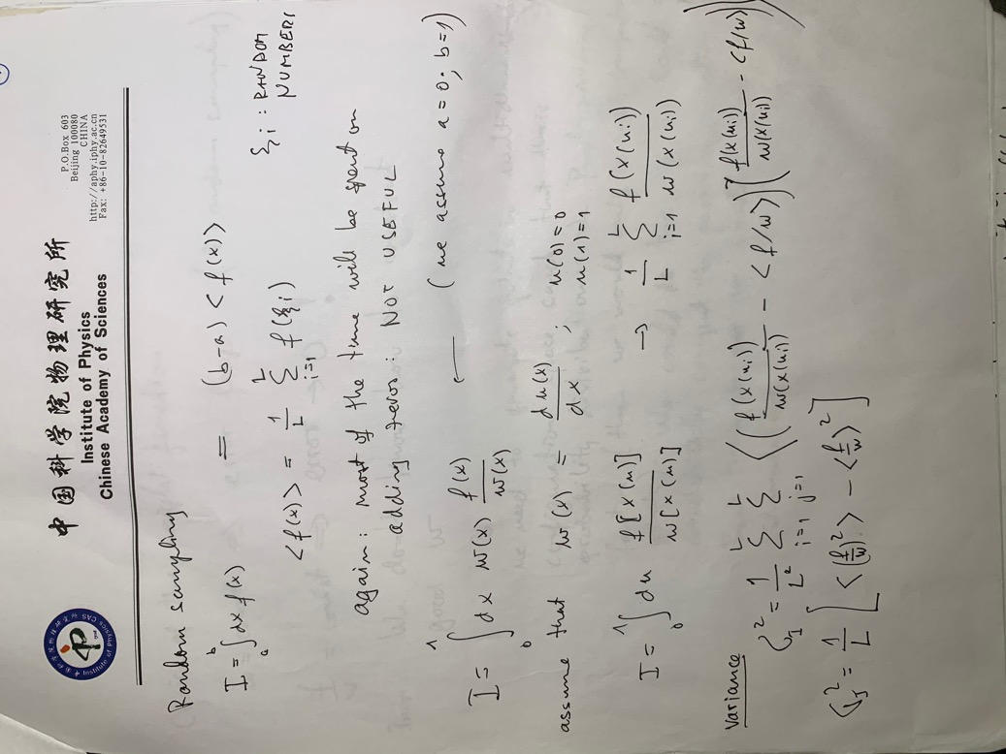
PART III: COMPUTER SIMULATIONS MONTE CARLO SIMULATIONS
DIRECT CALCULATION OF THE PARTITION FUNCTION IS NOT POSSIBLE…
We need a (much) smarter approach to estimate space averages!!
Random sampling: NOT BETTER
GENERAL WEIGHTED SAMPLING

Slide 13
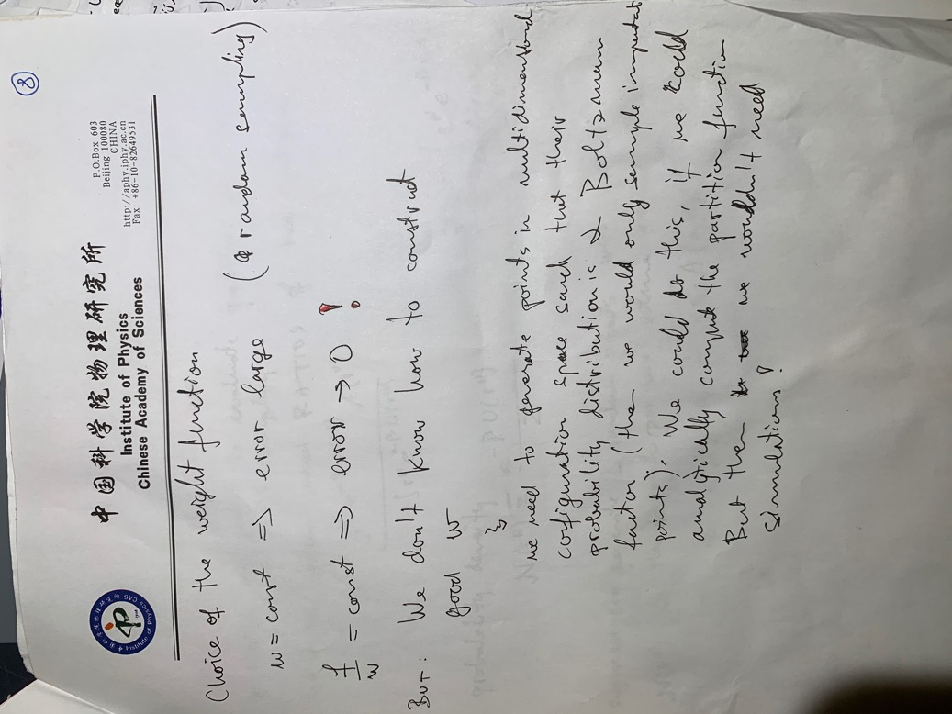
PART III: COMPUTER SIMULATIONS MONTE CARLO SIMULATIONS

Slide 14
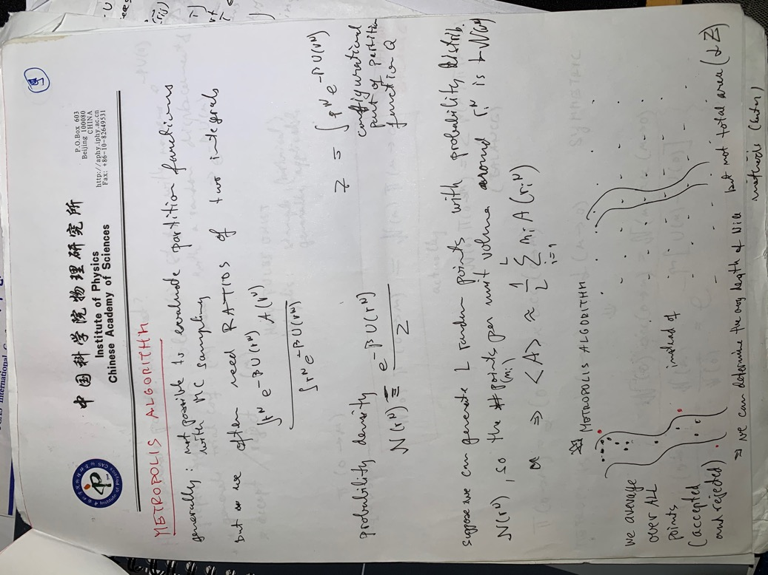
PART III: COMPUTER SIMULATIONS MONTE CARLO SIMULATIONS

Slide 15
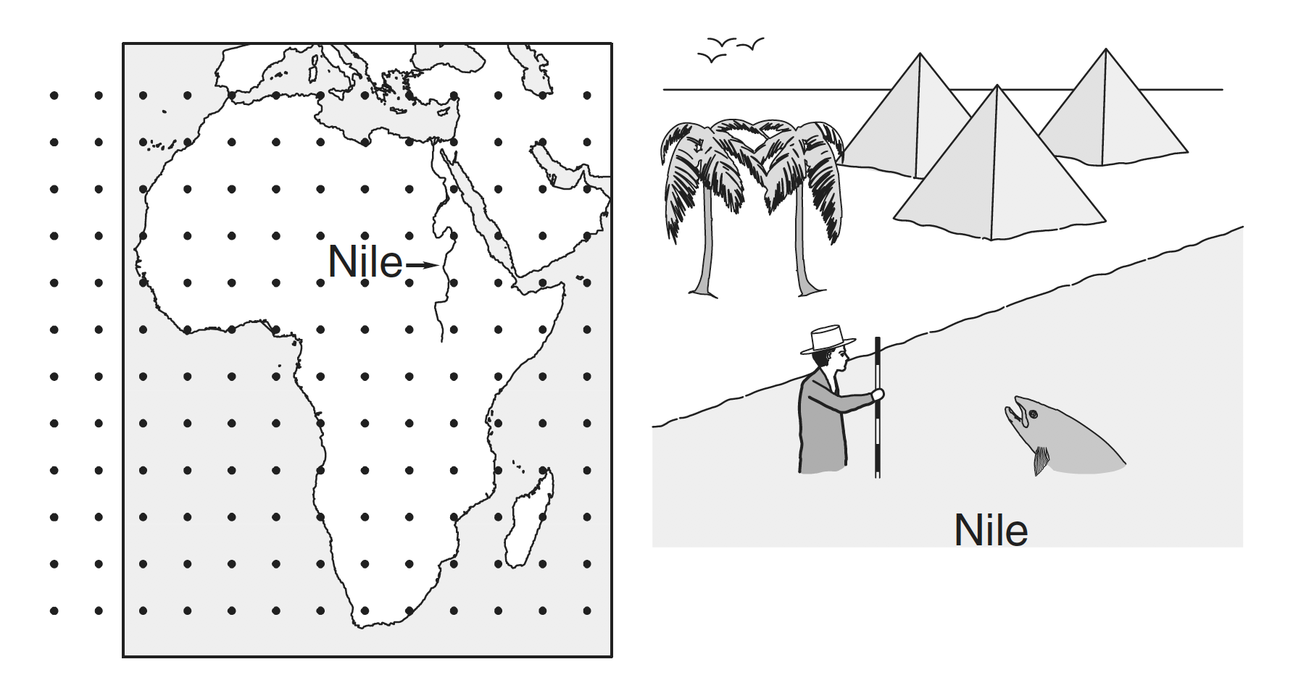
PART III: COMPUTER SIMULATIONS MONTE CARLO SIMULATIONS

Slide 16
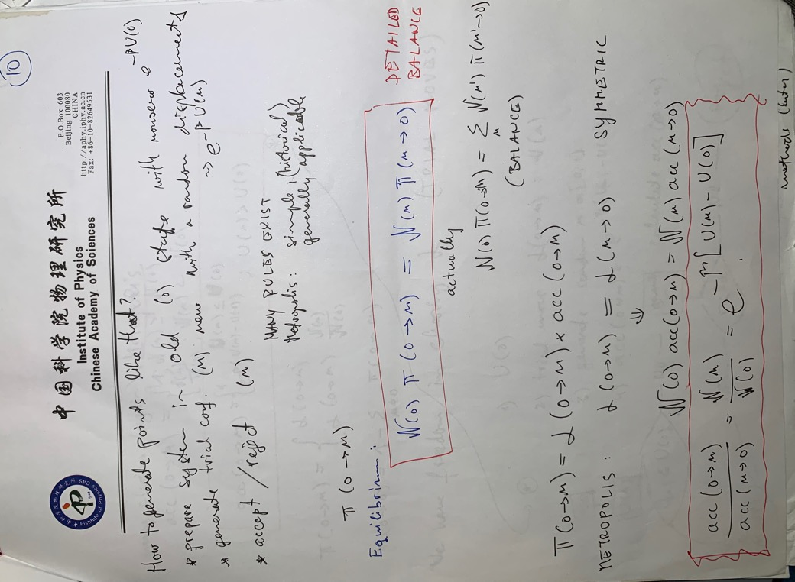
PART III: COMPUTER SIMULATIONS MONTE CARLO SIMULATIONS

Slide 17
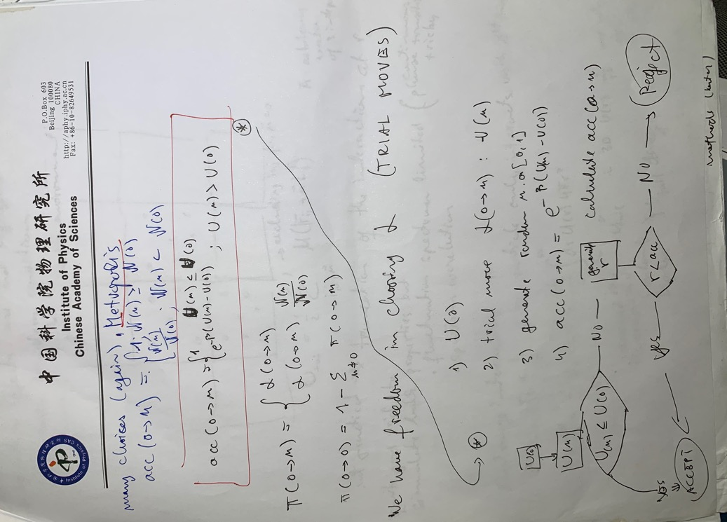
PART III: COMPUTER SIMULATIONS MONTE CARLO SIMULATIONS

Slide 18
PART III: COMPUTER SIMULATIONS MONTE CARLO SIMULATIONS

Slide 19
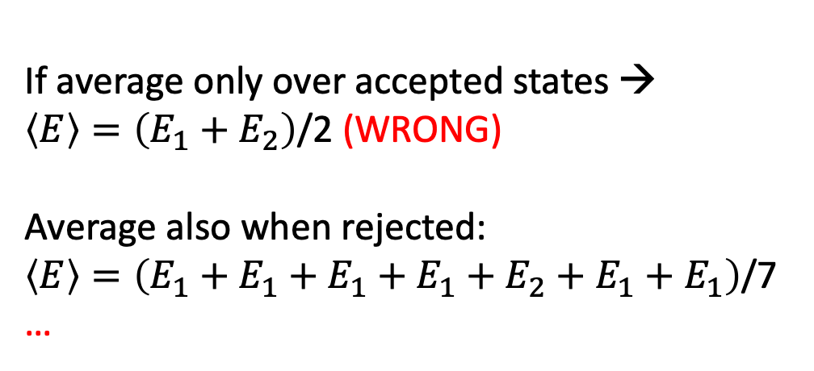
PART III: COMPUTER SIMULATIONS MONTE CARLO SIMULATIONS
E₂
AVERAGES: over accepted AND rejected states!!
Simple demonstration: two-level system…
E₁
OLD STATE | NEW STATE | DECISION
2 | 1 | ACCEPT
1 | 2 | REJECT
1 | 2 | REJECT
1 | 2 | REJECT
1 | 2 | ACCEPT
2 | 1 | ACCEPT
1 | 2 | REJECT
If average only over accepted states →
$\left\langle E\right\rangle =\left(E_{1}+E_{2}\right)$/2 (WRONG)
Average also when rejected:
$\left\langle E\right\rangle =\left(E_{1}+{E_{1}+E_{1}+E_{1}+E}_{2}+E_{1}+E_{1}\right)$/7
…

Slide 20
PART II: NUMERICAL METHODS RANDOM NUMBERS
RANDOM NUMBERS IN COMPUTATION
Why do we need random numbers?
Simulation of random processes (nuclear decay, Brownian motion, reactions, weather…, noise)
Probability (using randomness to test theories or estimate constants…)

Slide 21

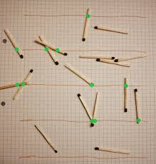
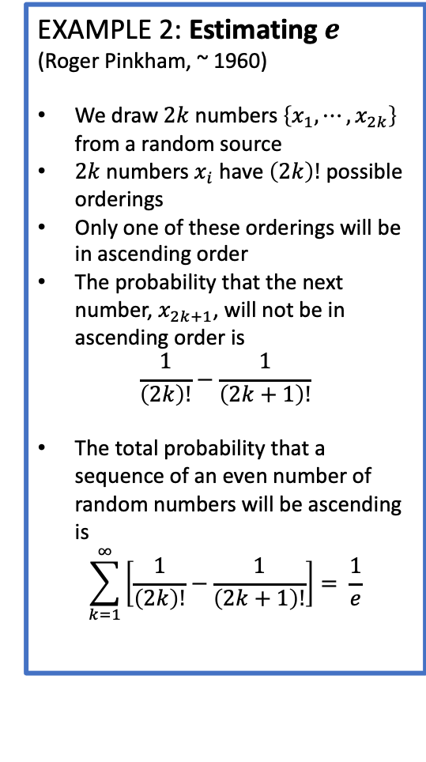
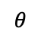
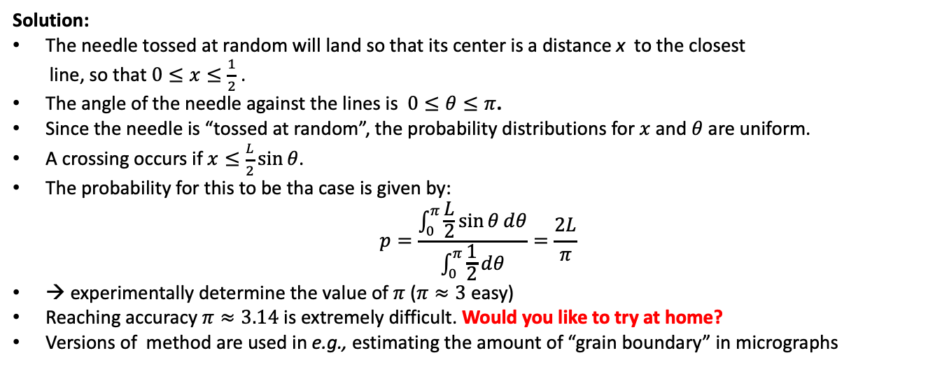
PART II: NUMERICAL METHODS RANDOM NUMBERS
EXAMPLE 1: Buffon needle
(G.L. leclerc, Comte de Buffon, 1773)
We toss a needle of length L randomly to a horizontal surface ruled with equally spaced lines (a = 1).
What is the probability of the needle crossing the line?
EXAMPLE 2: Estimating $e$
(Roger Pinkham, ~ 1960)
We draw $2k$ numbers $\left\{x_{1},⋯,x_{2k}\right\}$ from a random source
$2k$ numbers $x_{i}$ have $\left(2k\right)!$ possible orderings
Only one of these orderings will be in ascending order
The probability that the next number, $x_{2k+1}$, will not be in ascending order is
$$\frac{1}{\left(2k\right)!}−\frac{1}{\left(2k+1\right)!}$$
The total probability that a sequence of an even number of random numbers will be ascending is
$$\sum_{k=1}^{∞}{\left[\frac{1}{\left(2k\right)!}−\frac{1}{\left(2k+1\right)!}\right]}= \frac{1}{e}$$
L < 1
a = 1
Solution:
The needle tossed at random will land so that its center is a distance x to the closest
line, so that $0≤x≤\frac{1}{2}$ .
The angle of the needle against the lines is $0≤θ≤π$.
Since the needle is “tossed at random”, the probability distributions for $x$ and $θ$ are uniform.
A crossing occurs if $x≤\frac{L}{2}\sin{θ}$.
The probability for this to be tha case is given by:
$$p=\frac{\int_{0}^{π}{\frac{L}{2}\sin{θ}ⅆθ}}{\int_{0}^{π}{\frac{1}{2}ⅆθ}}=\frac{2L}{π}$$
→ experimentally determine the value of $π$ ($π≈3$ easy)
Reaching accuracy $π≈3.14$ is extremely difficult. Would you like to try at home?
Versions of method are used in e.g., estimating the amount of “grain boundary” in micrographs
$$θ$$
x

Slide 22
PART II: NUMERICAL METHODS RANDOM NUMBERS
Devices have been built and used based on similar
Problem: not possible to repeat events…
Sources of random numbers
Natural processes (cosmic rays, nuclear disintegration, random sampling of alternate frequency…)
Published tables of random digits
Creating longer table by manipulating published tables
Mathematical formulas (many versions, more or less complex and successful)
On a computer, we cannot generate a really random set of numbers! (calculations are deterministic)
We can generate a pseudo-random sequence, which has a long periodicity interval
Problems:
Slow to read from a tape or disk
1 million is not nearly enough for modern simulations…
e.g.
Rand Table of One Million Random Digits and One Hundred Thousand Normal Derivatives,
Free Press Chicago, 1955
Problems:
not elegant
still slow

Slide 23
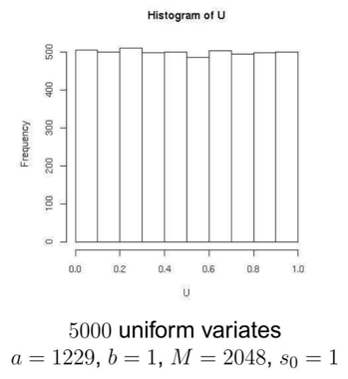
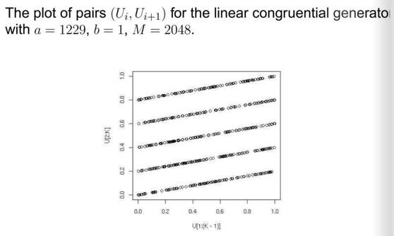
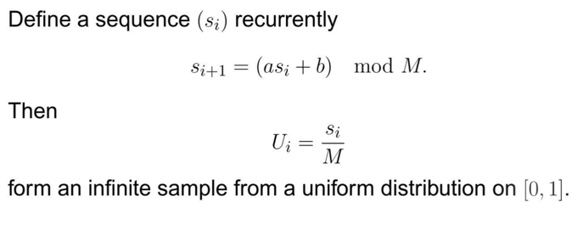
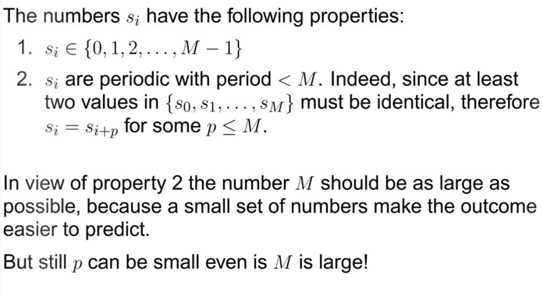
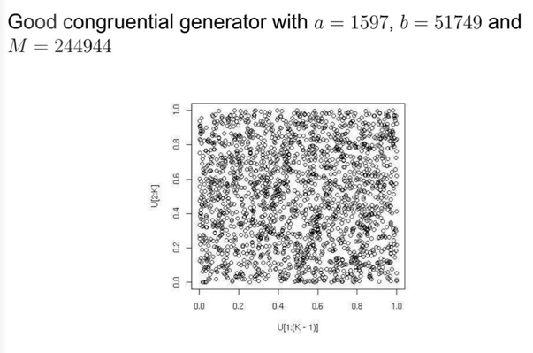


PART II: NUMERICAL METHODS RANDOM NUMBERS
Are the numbers $U_{i}$ uniformly distributed?
Are the numbers $U_{i}$ independent?
EXAMPLE: Congruential generators
Not very independent
Quite independent

Slide 24
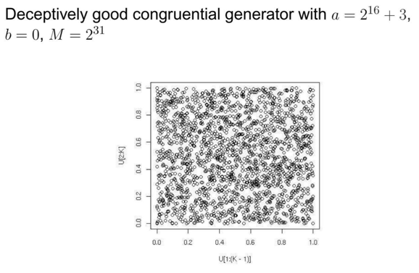
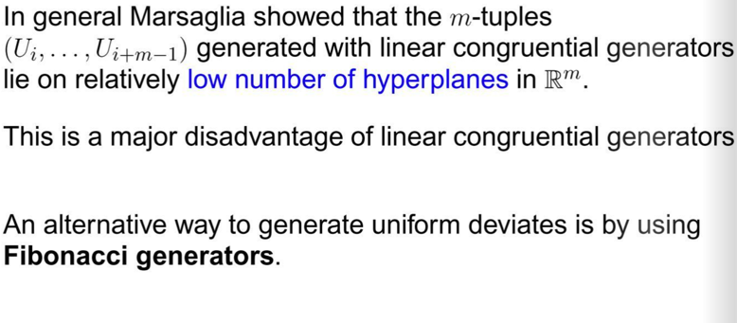
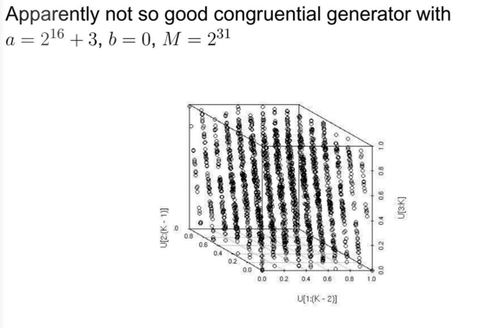
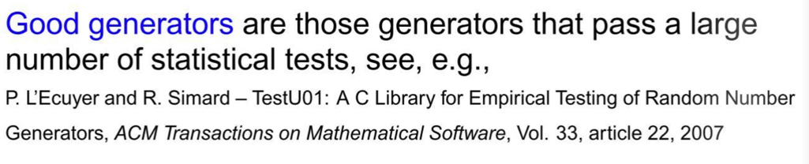
PART II: NUMERICAL METHODS RANDOM NUMBERS

Slide 25
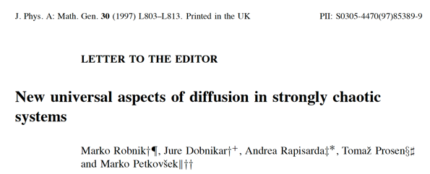
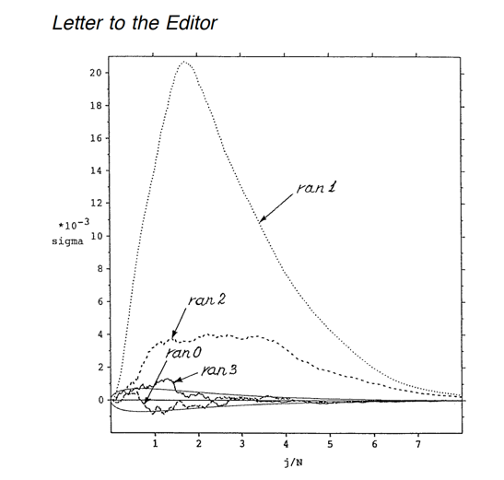
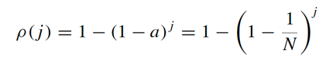
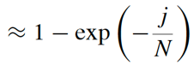
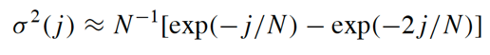
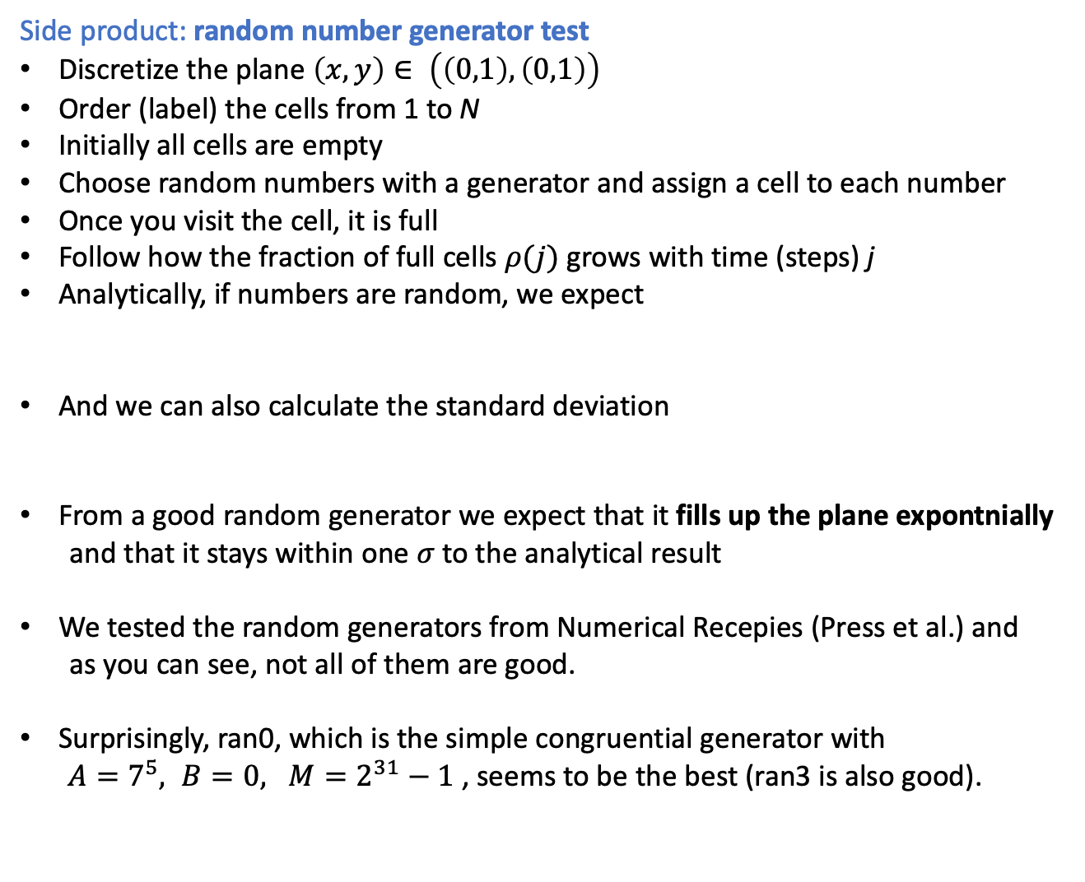
PART II: NUMERICAL METHODS RANDOM NUMBERS
My research work from 1997:
Side product: random number generator test
Discretize the plane $\left(x,y\right)∈ \left(\left(0,1\right),\left(0,1\right)\right)$
Order (label) the cells from 1 to N
Initially all cells are empty
Choose random numbers with a generator and assign a cell to each number
Once you visit the cell, it is full
Follow how the fraction of full cells $ρ(j)$ grows with time (steps) j
Analytically, if numbers are random, we expect
And we can also calculate the standard deviation
From a good random generator we expect that it fills up the plane expontnially
and that it stays within one $σ$to the analytical result
We tested the random generators from Numerical Recepies (Press et al.) and
as you can see, not all of them are good.
Surprisingly, ran0, which is the simple congruential generator with
$A=7^{5}, B=0, M=2^{31}−1$ , seems to be the best (ran3 is also good).

Slide 26
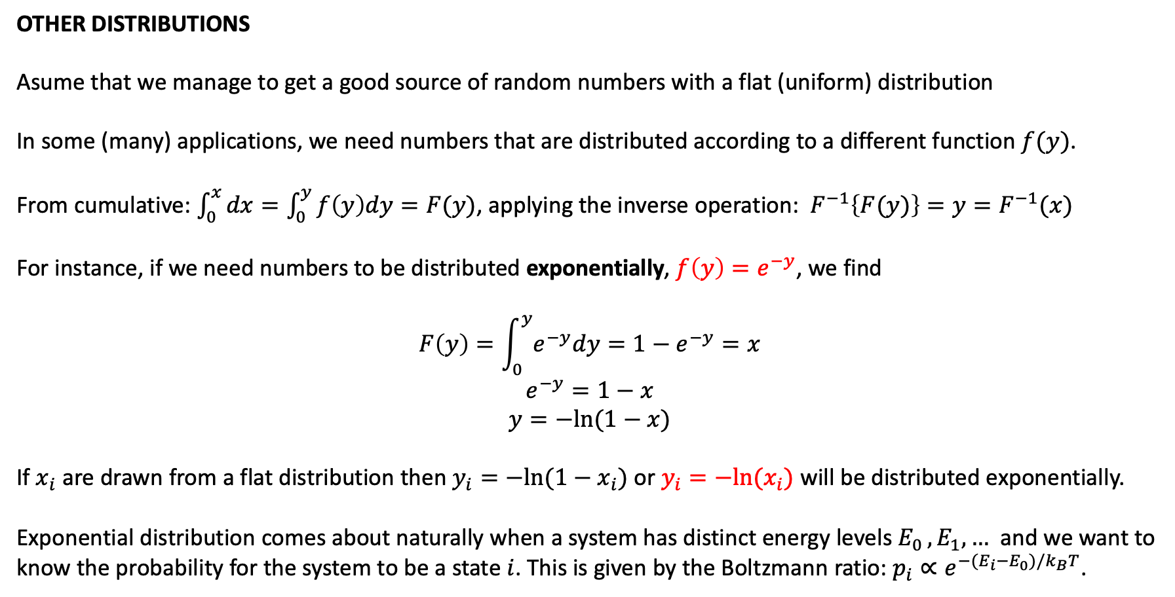
PART II: NUMERICAL METHODS RANDOM NUMBERS
OTHER DISTRIBUTIONS
Asume that we manage to get a good source of random numbers with a flat (uniform) distribution
In some (many) applications, we need numbers that are distributed according to a different function $f(y)$.
From cumulative: $\int_{0}^{x}{dx=\int_{0}^{y}{f\left(y\right)dy=F(y)}}$, applying the inverse operation: $F^{−1}\left\{F(y)\right\}=y=F^{−1}(x)$
For instance, if we need numbers to be distributed exponentially, $f\left(y\right)=e^{−y}$, we find
$$F\left(y\right)=\int_{0}^{y}{e^{−y}dy=1−e^{−y}=x}$$
$$e^{−y}=1−x$$
$$y=−ln⁡(1−x)$$
If $x_{i}$ are drawn from a flat distribution then $y_{i}=−ln⁡(1−x_{i})$ or $y_{i}=−ln⁡(x_{i})$ will be distributed exponentially.
Exponential distribution comes about naturally when a system has distinct energy levels $E_{0 }, E_{1}, …$ and we want to know the probability for the system to be a state $i$. This is given by the Boltzmann ratio: $p_{i}∝e^{−{(E}_{i}−E_{0})/k_{B}T}$.

Slide 27
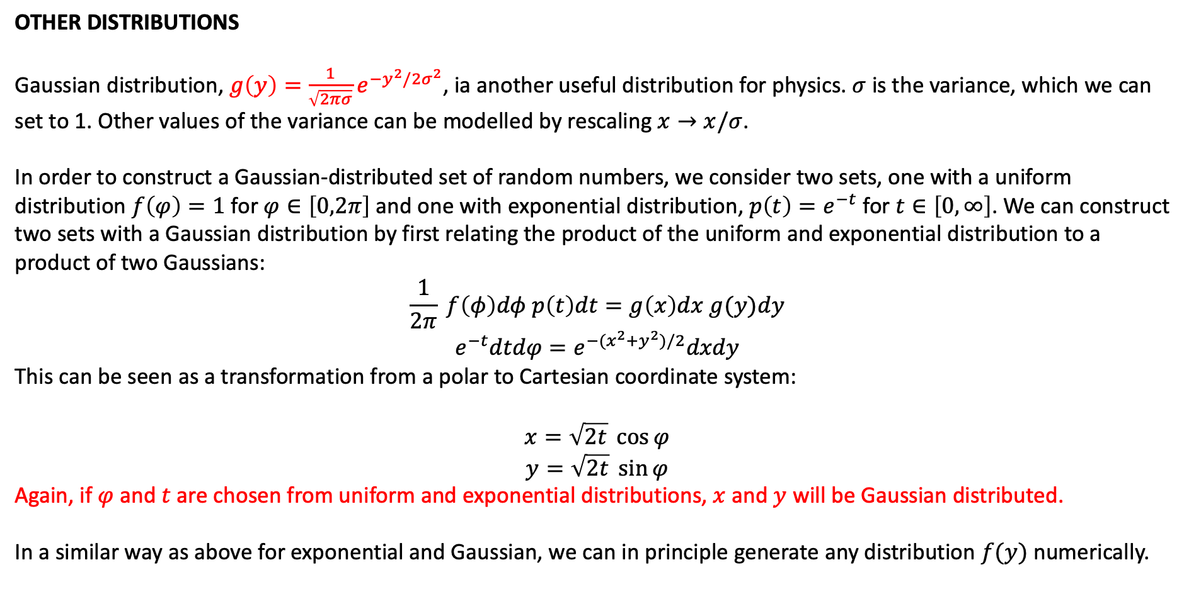
PART II: NUMERICAL METHODS RANDOM NUMBERS
OTHER DISTRIBUTIONS
Gaussian distribution, $g\left(y\right)={\frac{1}{\sqrt{2πσ}}e}^{−y^{2}/2σ^{2}}$, ia another useful distribution for physics. $σ$ is the variance, which we can set to 1. Other values of the variance can be modelled by rescaling $x→x/σ$.
In order to construct a Gaussian-distributed set of random numbers, we consider two sets, one with a uniform distribution $f\left(φ\right)=1$ for $φ∈\left[0,2π\right]$ and one with exponential distribution, $p\left(t\right)=e^{−t}$ for $t∈\left[0,∞\right]$. We can construct two sets with a Gaussian distribution by first relating the product of the uniform and exponential distribution to a product of two Gaussians:
$$\frac{1}{2π} f\left(φ\right)dφ p\left(t\right)dt=g\left(x\right)dx g(y)dy$$
$$e^{−t}dtdφ=e^{−(x^{2}+y^{2})/2}dxdy$$
This can be seen as a transformation from a polar to Cartesian coordinate system:
$$x=\sqrt{2t}\cos{φ}$$
$$y=\sqrt{2t} \sin{φ}$$
Again, if $φ$ and $t$ are chosen from uniform and exponential distributions, $x$ and $y$ will be Gaussian distributed.
In a similar way as above for exponential and Gaussian, we can in principle generate any distribution $f(y)$ numerically.

Slide 28
PART II: NUMERICAL METHODS RANDOM NUMBERS
HOME EXERCISE: Testing random numbers
Choose a few random number generators that you can think of
Test how uniform and independent they are and discuss the periodicity of the generated sequence
Perform the test of how they fill the plane that we discussed
Hints:
Most programming languages have built-in random number generators.
You can be creative in the way you create numbers, even if the “quality” is bad
Having a good random number generator is crucial for most computer simulations of materials where we extract the physical properties by averaging over fluctuations at the thermodynamic equilibrium!!

Slide 29
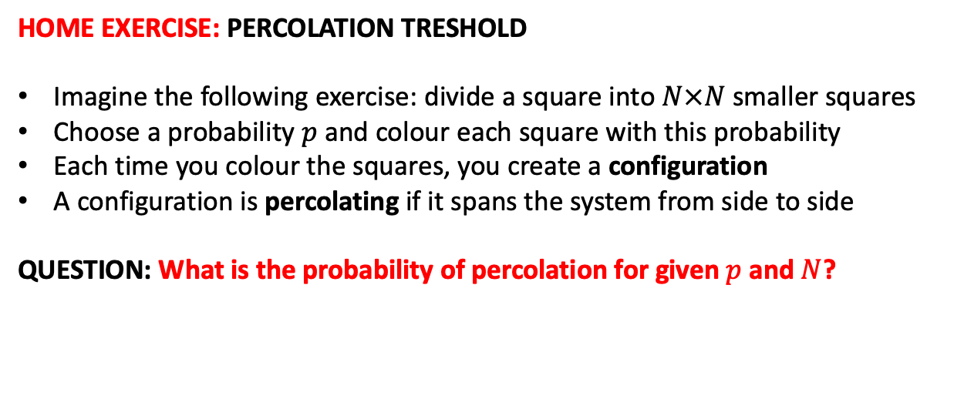
PART II: NUMERICAL METHODS RANDOM NUMBERS
HOME EXERCISE: PERCOLATION TRESHOLD
Imagine the following exercise: divide a square into $N×N$ smaller squares
Choose a probability $p$ and colour each square with this probability
Each time you colour the squares, you create a configuration
A configuration is percolating if it spans the system from side to side
QUESTION: What is the probability of percolation for given $p$ and $N$?
Non-percolating configuration
Horizontally percolating configuration

Slide 30
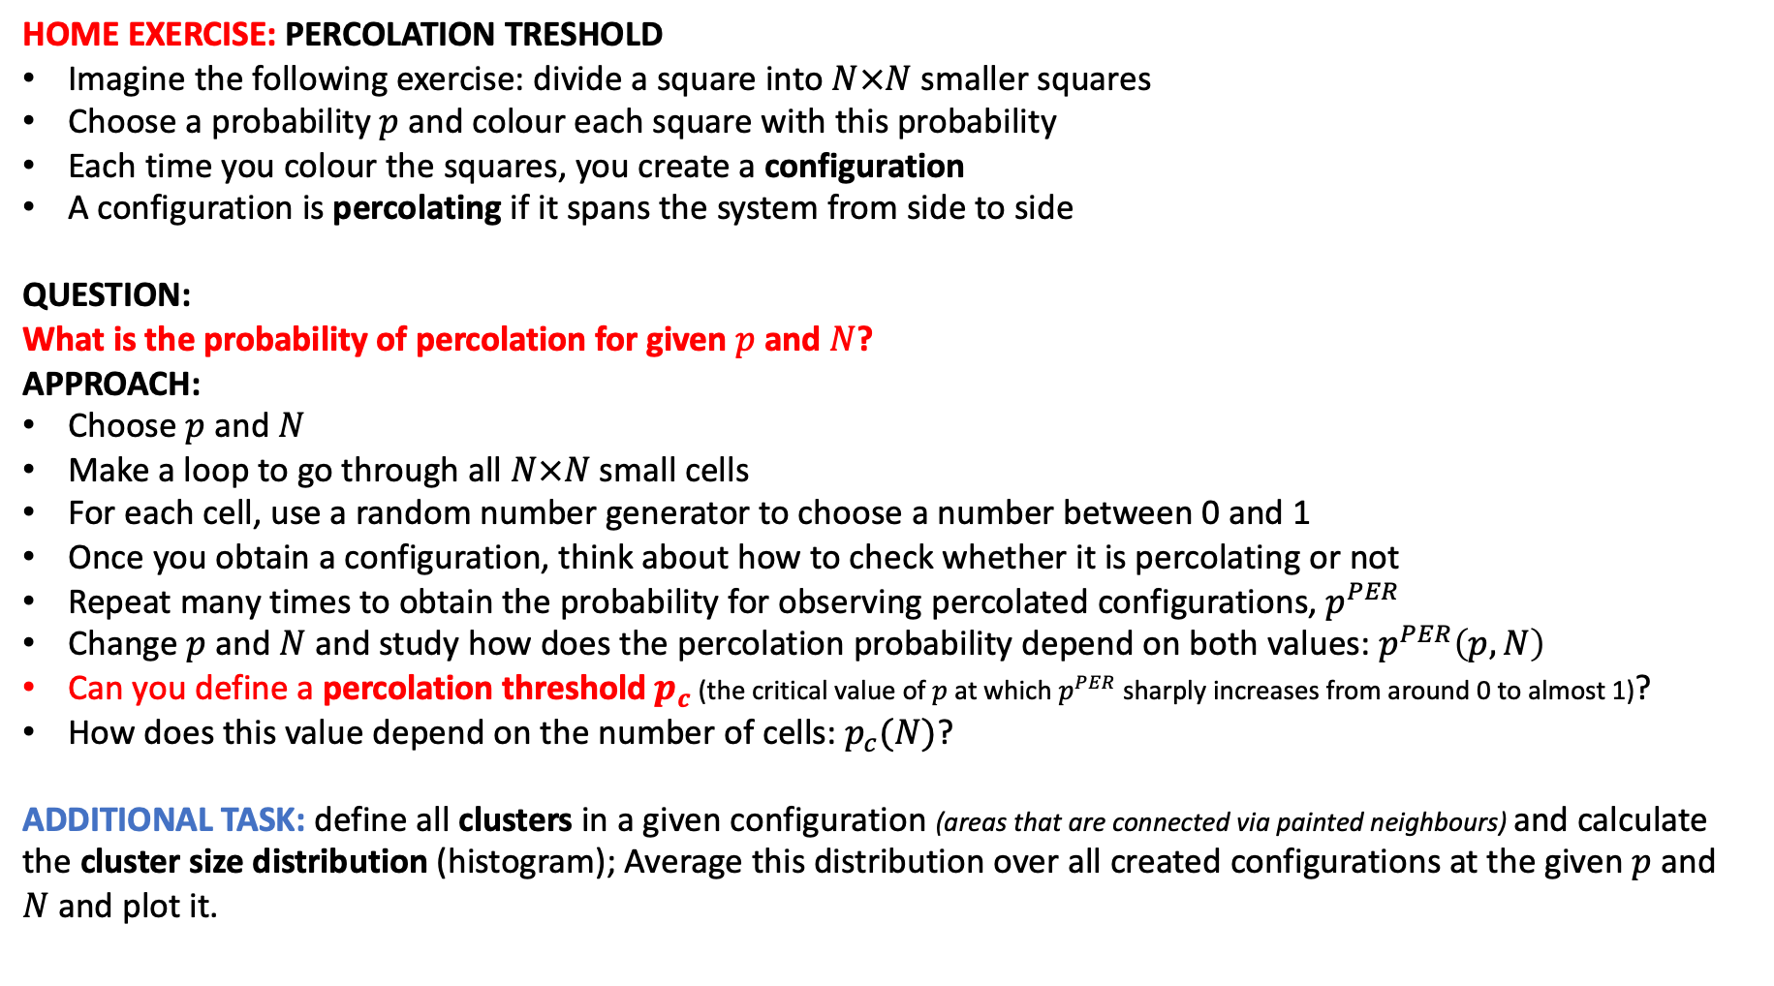
PART II: NUMERICAL METHODS RANDOM NUMBERS
HOME EXERCISE: PERCOLATION TRESHOLD
Imagine the following exercise: divide a square into $N×N$ smaller squares
Choose a probability $p$ and colour each square with this probability
Each time you colour the squares, you create a configuration
A configuration is percolating if it spans the system from side to side
QUESTION:
What is the probability of percolation for given $p$ and $N$?
APPROACH:
Choose $p$ and $N$
Make a loop to go through all $N×N$ small cells
For each cell, use a random number generator to choose a number between 0 and 1
Once you obtain a configuration, think about how to check whether it is percolating or not
Repeat many times to obtain the probability for observing percolated configurations, $p^{PER}$
Change $p$ and $N$and study how does the percolation probability depend on both values: $p^{PER}\left(p,N\right)$
Can you define a percolation threshold $p_{c}$ (the critical value of $p$ at which $p^{PER}$sharply increases from around 0 to almost 1)?
How does this value depend on the number of cells:$p_{c}(N)$?
ADDITIONAL TASK: define all clusters in a given configuration (areas that are connected via painted neighbours) and calculate the cluster size distribution (histogram); Average this distribution over all created configurations at the given $p$ and $N$and plot it.

Slide 31
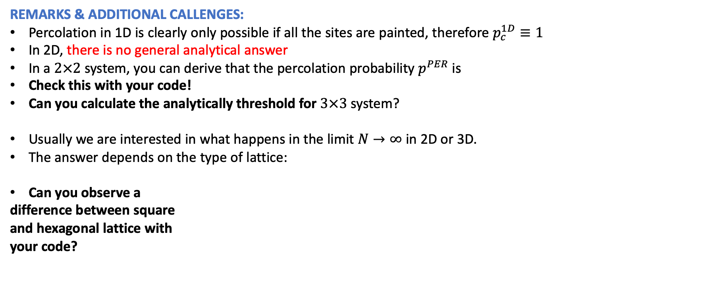
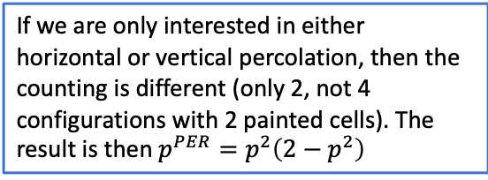
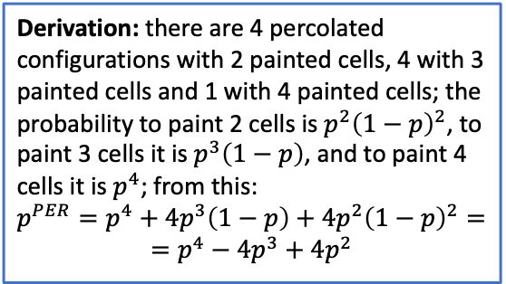
PART II: NUMERICAL METHODS RANDOM NUMBERS
REMARKS & ADDITIONAL CALLENGES:
Percolation in 1D is clearly only possible if all the sites are painted, therefore $p_{c}^{1D}≡1$
In 2D, there is no general analytical answer
In a $2×2$ system, you can derive that the percolation probability $p^{PER}$is
Check this with your code!
Can you calculate the analytically threshold for $3×3$ system?
Usually we are interested in what happens in the limit $N→∞$ in 2D or 3D.
The answer depends on the type of lattice:
Can you observe a
difference between square
and hexagonal lattice with
your code?
Derivation: there are 4 percolated configurations with 2 painted cells, 4 with 3 painted cells and 1 with 4 painted cells; the probability to paint 2 cells is $p^{2}{\left(1−p\right)}^{2}$, to paint 3 cells it is $p^{3}\left(1−p\right)$, and to paint 4 cells it is $p^{4}$; from this:
$$p^{PER}=p^{4}+4p^{3}\left(1−p\right)+4p^{2}{\left(1−p\right)}^{2}=$$
$$=p^{4}−4p^{3}+4p^{2}$$
If we are only interested in either horizontal or vertical percolation, then the counting is different (only 2, not 4 configurations with 2 painted cells). The result is then $p^{PER}=p^{2}\left(2−p^{2}\right)$

Slide 32
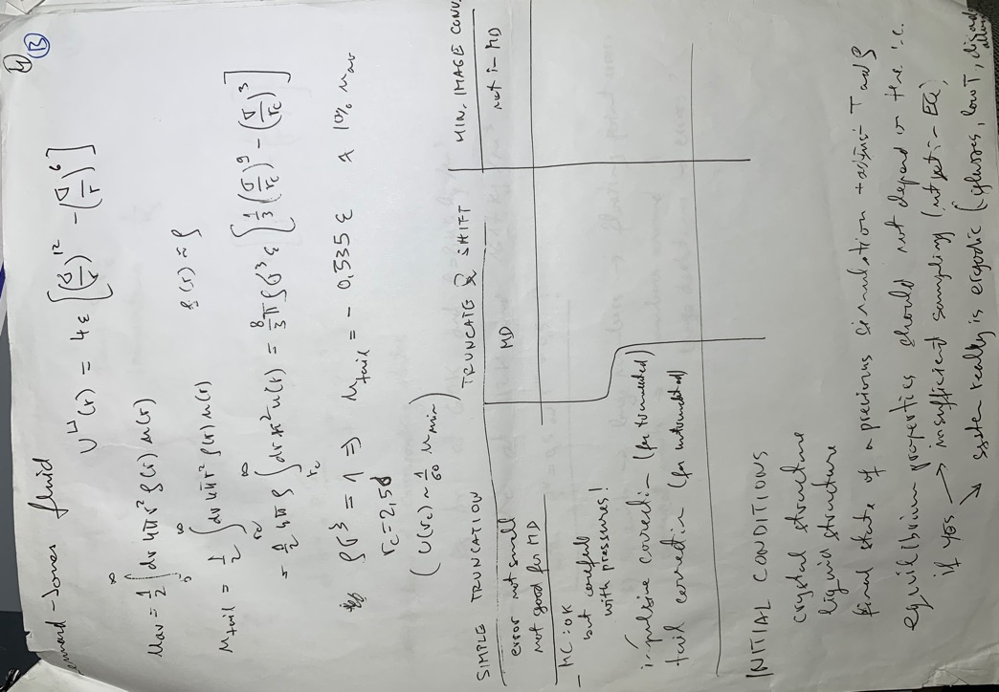
PART III: COMPUTER SIMULATIONS MONTE CARLO SIMULATIONS

Slide 33
PART III: COMPUTER SIMULATIONS MONTE CARLO SIMULATIONS
Pauli exclusion principle
Van der Waals fluctuation forces

Slide 34
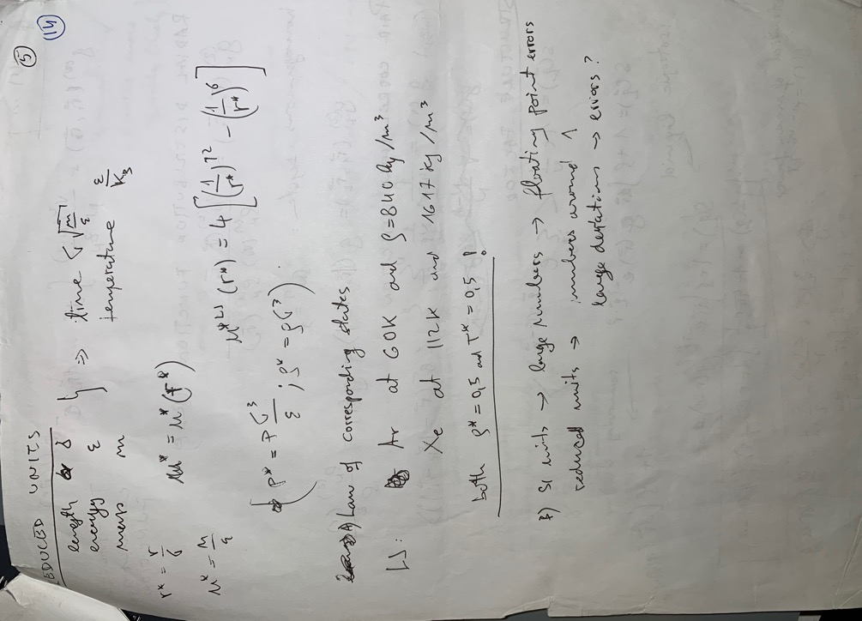



PART III: COMPUTER SIMULATIONS MONTE CARLO SIMULATIONS
Pauli exclusion principle
Van der Waals fluctuation forces

Slide 35








PART III: COMPUTER SIMULATIONS MONTE CARLO SIMULATIONS

Slide 36




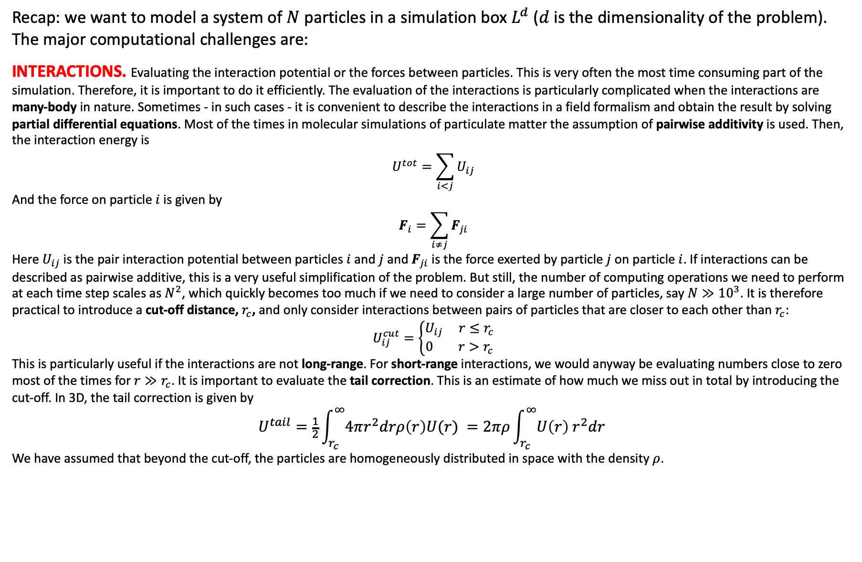





PART III: COMPUTER SIMULATIONS
Recap: we want to model a system of $N$ particles in a simulation box $L^{d}$ ($d$ is the dimensionality of the problem).
The major computational challenges are:
INTERACTIONS. Evaluating the interaction potential or the forces between particles. This is very often the most time consuming part of the simulation. Therefore, it is important to do it efficiently. The evaluation of the interactions is particularly complicated when the interactions are many-body in nature. Sometimes - in such cases - it is convenient to describe the interactions in a field formalism and obtain the result by solving partial differential equations. Most of the times in molecular simulations of particulate matter the assumption of pairwise additivity is used. Then, the interaction energy is
$$U^{tot}=\sum_{i<j}{U_{ij}}$$
And the force on particle $i$ is given by
$$F_{i}=\sum_{i≠j}{F_{ji}}$$
Here $U_{ij}$ is the pair interaction potential between particles $i$ and $j$ and $F_{ji}$ is the force exerted by particle $j$ on particle $i$. If interactions can be described as pairwise additive, this is a very useful simplification of the problem. But still, the number of computing operations we need to perform at each time step scales as $N^{2}$, which quickly becomes too much if we need to consider a large number of particles, say $N≫{10}^{3}$. It is therefore practical to introduce a cut-off distance, $r_{c}$, and only consider interactions between pairs of particles that are closer to each other than $r_{c}$:
$$U_{ij}^{cut}=\left\{\begin{matrix}U_{ij} r≤r_{c} \\ 0 r>r_{c}\end{matrix}\right.$$
This is particularly useful if the interactions are not long-range. For short-range interactions, we would anyway be evaluating numbers close to zero most of the times for $r≫r_{c}$. It is important to evaluate the tail correction. This is an estimate of how much we miss out in total by introducing the cut-off. In 3D, the tail correction is given by
$$U^{tail}=\frac{1}{2}\int_{r_{c}}^{∞}{4πr^{2}drρ\left(r\right)U(r) }=2πρ\int_{r_{c}}^{∞}{U\left(r\right) r^{2}dr }$$
We have assumed that beyond the cut-off, the particles are homogeneously distributed in space with the density $ρ$.

Slide 37
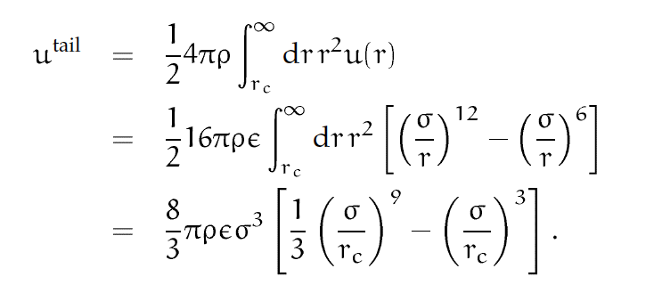

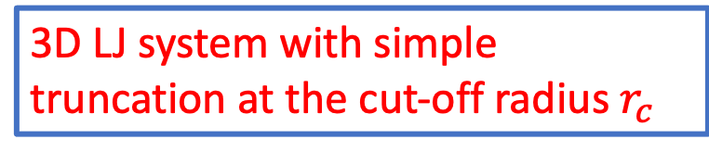





3D LJ system with simple truncation at the cut-off radius $r_{c}$

Slide 38







3D LJ system with simple truncation at the cut-off radius $r_{c}$

Slide 39





3D LJ system with simple truncation at the cut-off radius $r_{c}$
… for the system with untruncated interactions
Correction to obtain the limiting result for the system with truncated interactions

Slide 40


PART III: COMPUTER SIMULATIONS
We cannot simulate macroscopic systems with $𝒪\left({10}^{20}\right) atoms$.
Modern computer simulations can consider up to $\sim {10}^{6}$ particles (depends on the complexity of the model…
This is orders of magnitude smaller than bulk!!
SIMULATING MACROSCOPIC PROPERTIES / BOUNDARY CONDITIONS.

Slide 41




PART III: COMPUTER SIMULATIONS
SIMULATING MACROSCOPIC PROPERTIES / BOUNDARY CONDITIONS.
In a typical simulation there will be a non-negligible number of particles at the boundary (49% in a cubic crystal with 1000 particles and still 6 % even with 1000000 particles!!)
system size $N$ will affect the results!!!
boundary conditions will affect the results!!!
(e.g., Hard boundaries, Free boundaries, Periodic boundaries)

Slide 42







PART III: COMPUTER SIMULATIONS
PERIODIC BOUNDARY CONDITIONS. An attempt to mimic a bulk systems with a simulation in a small system accessible to computation. The system is replicated in all directions and the interactions are calculated as:
In order to make this approach useful, we usually apply the nearest image convention, i.e., we only consider one additional simulation box in each direction. We also keep the idea of cut-off. The periodic boundaries are surprisingly efficient in estimating bulk properties, however, we must be aware that they introduce spurious correlations with the length scale of the box size $L$, which are not present in the physical system. We must be very careful when analysing correlations!!

Slide 43


PART III: COMPUTER SIMULATIONS
FINITE SIZE ANALYSIS. Whatever boundary conditions we are using, it is essential that we establish how the measurable quantity in the simulation depends on the system size. To do this, we typically plot the computed quantity as a function of the inverse system size $1/N$. If the scaling is well-behaved, than the extrapolation $1/N→0$ is the bulk result we are looking for.

Slide 44



PART III: COMPUTER SIMULATIONS
EQUILIBRATION. The simulation starts from an initial condition, which is something we choose (usually either random positions of the particles or an ordered crystalline arrangement…). Before we start measuring averages, it is essential to make sure that we have reached the thermodynamic equilibrium. We can follow for instance the instantaneous and average energy of the system, and the energy fluctuations. Once the average energy levels off and the fluctuations are at the expected level according to the temperature, the simulation really begins.
EVALUATING MEASURABLES. The quantities we measure in a simulation are averages (either time averages in MD or ensemble averages in MC). Examples are: average energy, pressure, heat capacity, compressibility, elastic moduli, structure factor, radial distribution function, correlations, transport coefficients…

Slide 45
PART III: COMPUTER SIMULATIONS MONTE CARLO SIMULATIONS

Slide 46

PART III: COMPUTER SIMULATIONS MONTE CARLO SIMULATIONS

Slide 47

PART III: COMPUTER SIMULATIONS MONTE CARLO SIMULATIONS

Slide 48

PART III: COMPUTER SIMULATIONS MONTE CARLO SIMULATIONS

Slide 49

PART III: COMPUTER SIMULATIONS MONTE CARLO SIMULATIONS

Slide 50

PART III: COMPUTER SIMULATIONS MONTE CARLO SIMULATIONS

Slide 51

PART III: COMPUTER SIMULATIONS MONTE CARLO SIMULATIONS

Slide 52

PART III: COMPUTER SIMULATIONS MONTE CARLO SIMULATIONS

Slide 53

PART III: COMPUTER SIMULATIONS MONTE CARLO SIMULATIONS

Slide 54


PART III: COMPUTER SIMULATIONS MONTE CARLO SIMULATIONS
$$\frac{∂Z_{N}}{∂V}$$

Slide 55

PART III: COMPUTER SIMULATIONS MONTE CARLO SIMULATIONS

Slide 56

PART III: COMPUTER SIMULATIONS MONTE CARLO SIMULATIONS

Slide 57

PART III: COMPUTER SIMULATIONS MONTE CARLO SIMULATIONS

Slide 58

PART III: COMPUTER SIMULATIONS MONTE CARLO SIMULATIONS

Slide 59


PART III: COMPUTER SIMULATIONS MONTE CARLO SIMULATIONS
$$k>π/L$$

Slide 60





Trial Moves
Translational Moves
Basic Metropolis Mc algorithm:

Slide 61


Trial Moves
Efficient sampling: good ”value” for “money”
Computation time (+ human time?) ~ CPU time
High statistical accuracy
Mean-square error ~ # independent configurations visited ~ Distance travelled in configuration space
Displacing 1 particle at a time:
Displacing N particles at a time → factor 1/N
Better to displace a single particle
This is not true for correlated displacements!!

Slide 62


Trial Moves
Efficient sampling: good ”value” for “money”
Optimal values of $∆$ …?
Computation time (+ human time?) ~ CPU time
High statistical accuracy

Slide 63



Trial Moves
Translational Moves
Orientational Moves
Rigid Molecules
Non-Rigid Molecules (better with MD)
Euler angles → Quaternions: cheaper to evaluate (no trigonometric functions)

Slide 64

PART III: COMPUTER SIMULATIONS MOLECULAR DYNAMICS SIMULATIONS.
Follow the approach of a real experiment:
EXP: prepare the sample / connect the measuring instrument / measure the property in a time interval
MD: initialize & equilibrate / observable as a function of coordinates & momenta / average over a time interval
Equipartition: each degree of freedom that enters quadratically in Hamiltonian corresponds to $\frac{1}{2}k_{B}T$:$\left\langle \frac{1}{2}m_{i}{\left(v_{i}^{j}\right)}^{2}\right\rangle =\frac{1}{2}k_{B}T$
Evaluating temperature for $N$ particles in $d$ dimensions: $N_{f}=dN$ degrees of freedom:
$$T(t)=\frac{1}{{k_{B}N}_{f}}\sum_{i=1}^{N}{m_{i}{v_{i}}^{2}\left(t\right)}$$
Temperature, as the total kinetic energy, fluctuates. Relative temperature fluctuations are $∝\frac{1}{\sqrt{N_{f}}}$.
System with $N_{f}\sim {10}^{4}$ degrees of freedom: the relative temperature fluctuations of will be of the order $1\%$.
We need to average over long time (many fluctuations) to get an accurate measure for temperature!

Slide 65


SIMPLE MOLECULAR DYNAMICS PROGRAM
Read in the parameters (initial temperature, number of particles, density, time step…)
Initialize the system (select initial positions and velocities of all particles)
Compute the forces on all particles
Integrate Newton’s equations of motion
After completion of the central loop, compute the averages of measured quantities, and stop
This central loop is the core of the simulation. Two steps are repeated until we have computed the time evolution of the system for the desired length of time.

Slide 66






SIMPLE MOLECULAR DYNAMICS PROGRAM
Read in the parameters (initial temperature, number of particles, density, time step…)
Initialize the system (select initial positions and velocities of all particles)
Compute the forces on all particles
Integrate Newton’s equations of motion
After completion of the central loop, compute the averages of measured quantities, and stop
This central loop is the core of the simulation. Two steps are repeated until we have computed the time evolution of the system for the desired length of time.
Most time-consuming:
$N$ particles → $\frac{N \left(N−1\right)}{2}$ evaluations of the force (at each time step)
Simulation time generally scales $t∝N^{2}$
Advanced tricks can reduce this time to scale as $t∝N$

Slide 67



SIMPLE MOLECULAR DYNAMICS PROGRAM
Read in the parameters (initial temperature, number of particles, density, time step…)
Initialize the system (select initial positions and velocities of all particles)
Compute the forces on all particles
Integrate Newton’s equations of motion
After completion of the central loop, compute the averages of measured quantities, and stop
This central loop is the core of the simulation. Two steps are repeated until we have computed the time evolution of the system for the desired length of time.
Most time-consuming:
$N$ particles → $\frac{N \left(N−1\right)}{2}$ evaluations of the force (at each time step)
Simulation time generally scales $t∝N^{2}$
Advanced tricks can reduce this time to scale as $t∝N$
Calculating the force components in LJ system: $f_{x}=−\frac{∂U\left(r\right)}{∂x}=\frac{48x}{r^{2}}\left(\frac{1}{r^{12}}−\frac{1}{{2r}^{6}}\right)$
Tip: no need to calculate the distance $r_{ij}=\sqrt{{\left(x_{i}−x_{j}\right)}^{2}+{\left(y_{i}−y_{j}\right)}^{2}+{\left(z_{i}−z_{j}\right)}^{2}}$, since we only need $r_{ij}^{2}$!! This saves a lot of time…

Slide 68


PART III: COMPUTER SIMULATIONS INTEGRATING EQUATIONS OF MOTION.
Md vs MC:
In MD we follow physical dynamics by solving Newton’s equation of motion: a real physical trajectory of the system.
However: in an ergodic system, trajectory will exponentially deviate from the real trajectory (Lyapunov instability)!
After sufficient time: no correlation between the computed and real trajectory.

Slide 69


PART III: COMPUTER SIMULATIONS INTEGRATING EQUATIONS OF MOTION.
Theorem of shadow Hamiltonian → if propagator is area preserving and time reversable (for instance, Verlet algorithm), any computed trajectory will be infinitesimally close to some real trajectory (although with a different initial condition). This ensures that the time averages in MD simulations will be meaningful.

Slide 70
PART III: COMPUTER SIMULATIONS INTEGRATING EQUATIONS OF MOTION.
MD simulations vs numerical computation
(e.g. predicting orbits of satellites)
In MD, we cannot say anything about the actual trajectory of the system starting from exact initial condition.
What we can predict, are thermodynamic averages.
Predicting exact trajectories is a different undertaking. It cannot be done for a large number of particles and it consists of a combination of forward and backward simulations to ensure that the trajectories are stable…

Slide 71










PART III: COMPUTER SIMULATIONS
Liouville operator
Integrating equations of motion (does not help us yet…)
Trotter identity

Slide 72






One time step

Slide 73

One time step
Verlet algorithm…

Slide 74




Euler algorithm
UNSTABLE (Energy drift…)
NOT reversible
NOT area preserving
Verlet algorithm
STABLE (very small energy drift…)
- reversible
- area preserving

Slide 75






→ Construct Verlet-like algorithms with:
EQUIVALENT TRAJECTORIES (show yourself)
Better estimates for the velocities
Original Verlet algorithm
We can compute velocities after we get the positions…
Leap-frog algorithm
(velocities at half-intervals)
Velocity-Verlet algorithm
Beeman algorithm

Slide 76


PART III: COMPUTER SIMULATIONS
Conjugate variables

Slide 77
PART III: COMPUTER SIMULATIONS
Conjugate variables

Slide 78

PART III: COMPUTER SIMULATIONS

Slide 79
PART III: COMPUTER SIMULATIONS

Slide 80

PART III: COMPUTER SIMULATIONS

Slide 81
PART III: COMPUTER SIMULATIONS

Slide 82


PART III: COMPUTER SIMULATIONS

Slide 83

PART III: COMPUTER SIMULATIONS
Gibbs ensemble (for coexistence problems…)

Slide 84


PART III: COMPUTER SIMULATIONS
CONSTANT TEMPERATURE
N particles
Probability to find the system in a state with a given energy is given by the Boltzmann factor
→ Maxwell distribution of the momenta (velocities)
Heat bath, T
Temperature:

Slide 85




PART III: COMPUTER SIMULATIONS
Relative variance of the kinetic energy:

Slide 86

PART III: COMPUTER SIMULATIONS
→ Relative variance of temperature:
CONSTANT TEMPERATURE $≠$ CONSTANT KINETIC ENERGY !!!

Slide 87

PART III: COMPUTER SIMULATIONS
How to properly fix the temperature in MD simulations?
NVE → NVT
Several ways…
ANDERSEN THERMOSTAT

Slide 88
PART III: COMPUTER SIMULATIONS
Normal MD moves following the Newtonian dynamics
Additional MC moves that represent stochastic collisions of a randomly chosen particle with the thermostat

Slide 89

PART III: COMPUTER SIMULATIONS
Normal MD moves following the Newtonian dynamics
Additional MC moves that represent stochastic collisions of a randomly chosen particle with the thermostat
STRENGHT OF THE COUPLING TO HEAT BATH $\sim$FREQUENCY OF COLLISION MOVES $(ν)$
Unrelated (random) events: Poissonian statistics of collisions

Slide 90

PART III: COMPUTER SIMULATIONS
Normal MD moves following the Newtonian dynamics
Additional MC moves that represent stochastic collisions of a randomly chosen particle with the thermostat
STRENGHT OF THE COUPLING TO HEAT BATH $\sim$FREQUENCY OF COLLISION MOVES $(ν)$
Unrelated (random) events: Poissonian statistics of collisions

Slide 91

PART III: COMPUTER SIMULATIONS
Normal MD moves following the Newtonian dynamics
Additional MC moves that represent stochastic collisions of a randomly chosen particle with the thermostat
STRENGHT OF THE COUPLING TO HEAT BATH $\sim$FREQUENCY OF COLLISION MOVES $(ν)$
Unrelated (random) events: Poissonian statistics of collisions
Guarantees Canonical distribution

Slide 92


PART III: COMPUTER SIMULATIONS

Slide 93


PART III: COMPUTER SIMULATIONS
Diffusion coefficient
Unrealistic dynamics
(sudden decorrelation of particle velocities…)
In principle unphysical dynamics
Small collision rates: better (but still unphysical)
All static properties (pressure, potential energy, structure…) are independent of $ν$

Slide 94




EXTENDED LAGRANGIAN
(new degrees of freedom)

Slide 95



Real & virtual variables
Variable s : scaling of the time step
$∆t$ fluctuates…

Slide 96


More gentle response to sudden change of velocities than Andersen
Problems (e.g. 1D harmonic oscillator…)

Slide 97



PART III: COMPUTER SIMULATIONS
Computer experiments
Temperature
Pressure
Heat capacity
Potential energy…
Structural properties…

Slide 98

PART III: COMPUTER SIMULATIONS DIFFUSION
Diffusion

Slide 99
PART III: COMPUTER SIMULATIONS DIFFUSION

Slide 100
PART III: COMPUTER SIMULATIONS DIFFUSION

Slide 101

PART III: COMPUTER SIMULATIONS DIFFUSION

Slide 102

PART III: COMPUTER SIMULATIONS DIFFUSION

Slide 103
PART III: COMPUTER SIMULATIONS

Slide 104






PART III: COMPUTER SIMULATIONS
Shear viscosity
Thermal conductivity
Electrical conductivity

